Slide 1

ARTIFICIAL INTELLIGENCE
&
MACHINE LEARNING
Lab SESSION NO : 5
Classical Search – Uninformed Search (Part 1)
BFS, DFS.

Slide 2
Objectives
1. Introduce the concept of classical search techniques in Artificial Intelligence.
2. Present the characteristics and limitations of uninformed search strategies.
3. Explore the working principles of Breadth-First Search (BFS), Depth-First Search (DFS), Uniform Cost Search (UCS), and Iterative Deepening Search (IDS).
4. Demonstrate each search method through graph-based or tree-based problem scenarios.

Slide 3
Essence of search
The essence of search in artificial intelligence (AI) revolves around systematically exploring a problem space to find a solution.
There are a finite number of states in a route-finding problem (20) – One for each city
There are an infinite number of paths in the state space
There can be loops in the paths which need to be avoided
A tree node is a search path, which means there are an infinite number of nodes

Slide 4
Process for searching

Slide 5
Search Algorithms in AI
Artificial Intelligence is the study of building agents that act rationally. Most of the time, these agents perform some kind of search algorithm in the background in order to achieve their tasks.
A search problem consists of:
A State Space. Set of all possible states where you can be.
A Start State. The state from where the search begins.
A Goal State. A function that looks at the current state returns whether or not it is the goal state.

Slide 6
CONTD..
The Solution to a search problem is a sequence of actions, called the plan that transforms the start state to the goal state. This plan is achieved through search algorithms.
Types of search algorithms:
There are far too many powerful search algorithms out there to fit in a single article. Instead, this article will discuss six of the fundamental search algorithms, divided into two categories.
1. Uninformed Search
2. Informed Search

Slide 7
Measuring problem-solving performance
Completeness: Is the algorithm guaranteed to find a solution when there is one?
Optimality: Does the strategy find the optimal solution
Time complexity: How long does it take to find a solution?
Space complexity: How much memory is needed to perform the search?

Slide 8
Measuring problem-solving performance
Path cost: How much does it cost?
Search space size: How many states does it involve
Number of states explored: Explain the extent of the search effort
Heuristic Evaluation: Effectiveness of heuristics?
Search Path Length: Number of steps or actions involved in generating the solution?
Search Depth or Breadth: The largest breadth and depth of the search

Slide 9
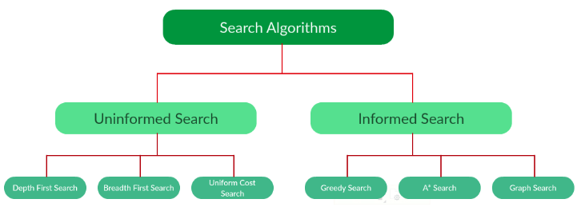
CONTD..

Slide 10
Uninformed Search Algorithms:
The search algorithms have no additional information on the goal node other than the one provided in the problem definition.
The plans to reach the goal state from the start state differ only by the order and/or length of actions.
Uninformed search is also called Blind search.
These algorithms can only generate the successors and differentiate between the goal state and non goal state.
uninformed search is often used when the solution space is large,
uninformed search algorithms play an important role in solving fundamental AI tasks, especially when no prior knowledge about the solution is available.

Slide 11
The following uninformed search algorithms are discussed in this section.
Depth First Search
Breadth First Search
Uniform Cost Search
Iterative Deepening Search (IDS)

Slide 12
CONTD..
Each of these algorithms will have:
A problem graph, containing the start node S and the goal node G.
A strategy, describing the manner in which the graph will be traversed to get to G.
A fringe, which is a data structure used to store all the possible states (nodes) that you can go from the current states.
A tree, that results while traversing to the goal node.
A solution plan, which the sequence of nodes from S to G.

Slide 13
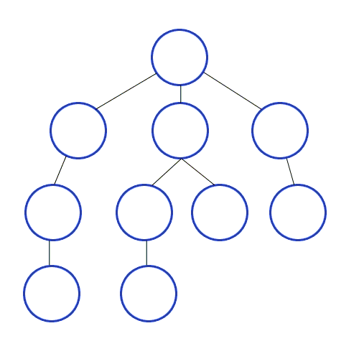
Depth-First Search (DFS)

Slide 14
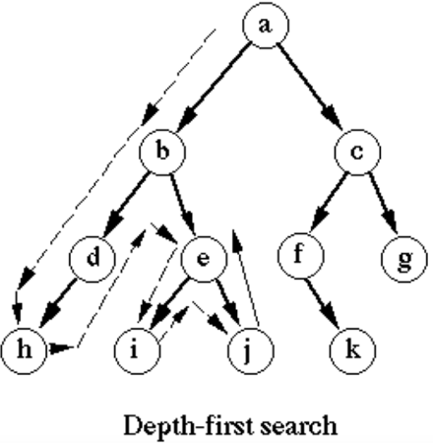

Slide 15
CONTD..
Algorithm Pseudocode:
1. Initialize an empty stack and push the root node onto it.
2. While the stack is not empty:
a. Pop the top node.
b. If this node is the goal, return the solution.
c. Else, push all unvisited neighboring nodes onto the stack.
3. Repeat the process until the goal is found or the stack is empty.
Example
Traversing a binary tree
Consider the following binary tree:

Slide 16
Time and space complexity
Time Complexity:
In the worst-case scenario, DFS has a time complexity of O(∣V∣+∣E∣), where |V| is the number of vertices in the graph or tree and |E| is the number of edges.
This is because DFS visits every vertex and edge once.
However, the time complexity can be reduced to O(∣V∣) if the graph or tree is a simple connected graph.
Space Complexity:
The space complexity of DFS is proportional to the tree's height or the graph's maximum depth.
In the worst-case scenario, where the tree or graph is very deep and has no branches, the space complexity of DFS is O(h) where h is the tree's height.
This is because DFS uses a recursive function call stack to keep track of the current path being traversed.

Slide 17
Advantages
Memory efficiency:
DFS uses less memory than breadth-first search because it only needs to keep track of a single path at a time.
Finds a solution quickly:
If the solution to a problem is located deep in a tree, DFS can quickly reach it by exploring one path until it reaches the solution.
Easy to implement:
DFS is a simple algorithm to understand and implement, especially when using recursion.
Can be used for certain types of problems:
DFS is particularly useful for problems that involve searching for a path, such as maze-solving or finding the shortest path between two nodes in a graph

Slide 18
Disadvantages
Can get stuck in infinite loops:
DFS can get stuck in an infinite loop if there are cycles in the graph or tree. This can be avoided by keeping track of visited nodes.
May not find the optimal solution:
DFS only sometimes finds the shortest path to a solution. It may find a suboptimal path before finding the shortest one.
Can take a long time:
In some cases, DFS may take a long time to find a solution, especially if the solution is located far from the starting node.

Slide 19
Breadth-First Search (BFS)
Breadth-First Search (BFS) is one of the simplest uninformed search algorithms.
It explores nodes level by level, starting from the root of the search tree and expanding all nodes at the present depth before moving on to nodes at the next depth level.
BFS is particularly useful in scenarios where the goal is located close to the starting point, as it guarantees that the shortest path in an unweighted graph will be found.
BFS can be implemented using a queue data structure, where nodes are added to the back of the queue as they are encountered and removed from the front when they are expanded. The algorithm proceeds by exploring all neighboring nodes of a given node, adding them to the queue, and repeating the process until the goal is reached.

Slide 20
CONTD..
Algorithm Pseudocode:
Initialize an empty queue and enqueue the root node.
While the queue is not empty:
a. Dequeue the front node.
b. If this node is the goal, return the solution.
c. Else, enqueue all unvisited neighboring nodes.
3. Repeat the process until the goal is found or the queue is empty.

Slide 21
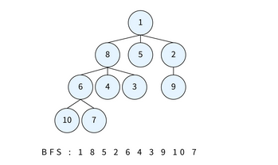
CONTD..

Slide 22
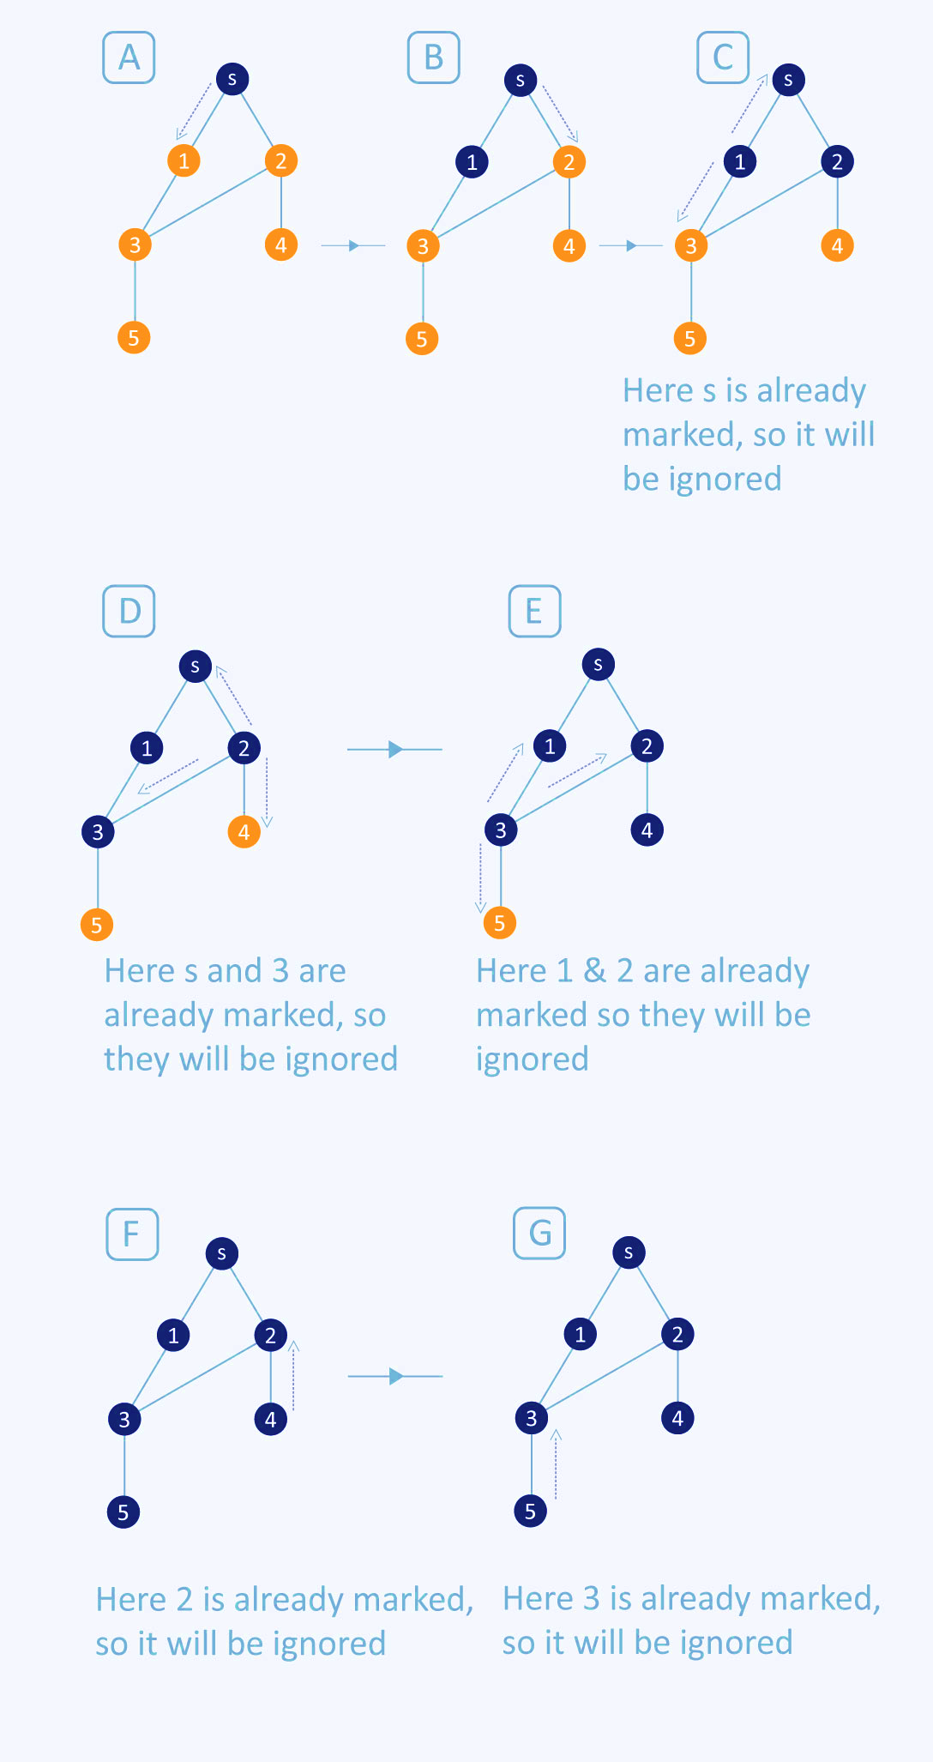

Slide 24
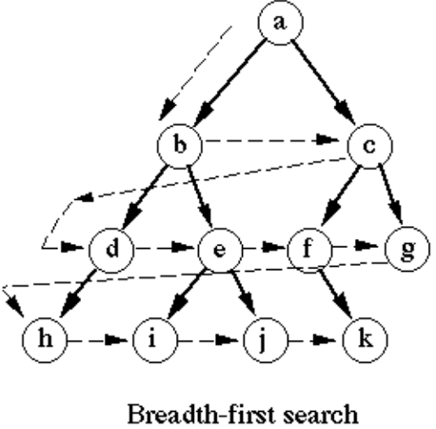

Slide 25
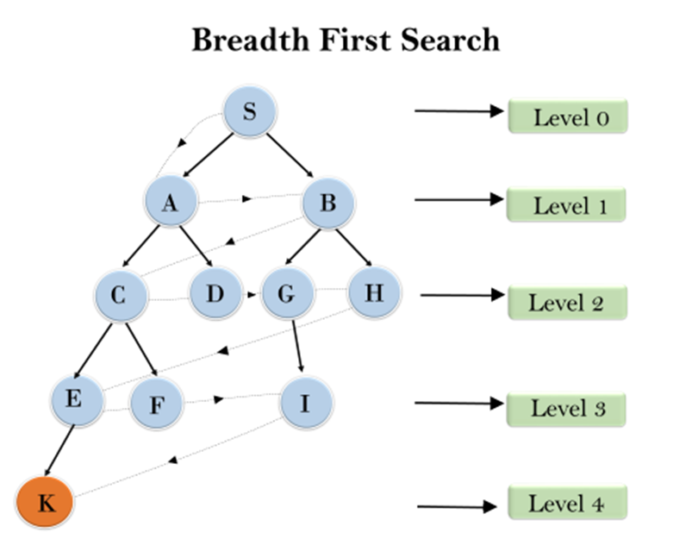
. Breadth-first Search

Slide 26
. Breadth-first Search
Time Complexity:
Time Complexity of BFS algorithm can be obtained by the number of nodes traversed in BFS until the shallowest Node. Where the d= depth of shallowest solution and b is a node at every state. T (b) = 1+b²+b³+.......+ b^{d}= O (b^{d})
Space Complexity:
Space complexity of BFS algorithm is given by the Memory size of frontier which is O(b^{d}).
Completeness:
BFS is complete, which means if the shallowest goal node is at some finite depth, then BFS will find a solution.
Optimality: BFS is optimal if path cost is a non-decreasing function of the depth of the node.

Slide 27
Bidirectional Search
Bidirectional Search is an algorithm that simultaneously searches forward from the initial state and backward from the goal state until the two searches meet.
This method can significantly reduce the search time, as each search only needs to explore half the depth of the search space.

Slide 28
Bidirectional Search
Completeness: Bidirectional search is complete if both searches use an algorithm like BFS.
Optimality: Bidirectional search is optimal if both searches use BFS and all step costs are equal.
Time Complexity: O(b^(d/2)), where b is the branching factor and d is the depth of the solution. This is exponentially faster than O(b^d).
Space Complexity: O(b^(d/2)), as it needs to store the nodes at the frontier of both searches.

Slide 29
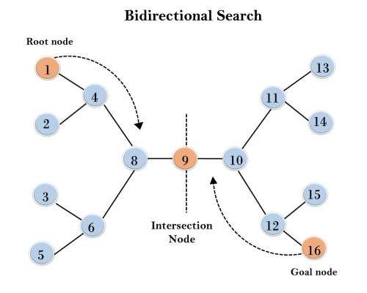
Bidirectional Search

